Slide 1


Part I
Center for Animal Disease Modeling and Surveillance (CADMS),
School of Veterinary Medicine, UC Davis
Jose Pablo Gomez, Jerome Baron, Jose Manuel Diaz Cao
Beatriz Martinez Lopez
Center for Animal Disease Modeling and Surveillance (CADMS)
Department of Medicine & Epidemiology
School of Veterinary Medicine
University of California, Davis
Emails: jpgo@ucdavis.edu
jnbaron@ucdavis.edu
https://jpablo91.github.io
https://cadms.vetmed.ucdavis.edu/
Notes:
Change to new cadms website

Slide 2
Table of contents
Introduction to networks
What is a network?
Elements of a network
Data
Sources
Sampling
Static network analysis
Network simplification
Network properties
Weak and Strong component
Notes:
Cuando describimos las caracteristias de la red, Podemos describer:
Caracteristicas generals, que nos daran una perspectiva general de como esta la red
Caracteristicas locales, que nos daran informacion a nivel de nodo o edge

Slide 3

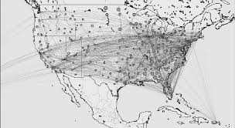
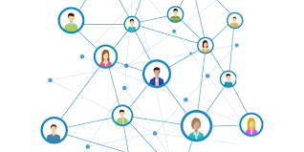
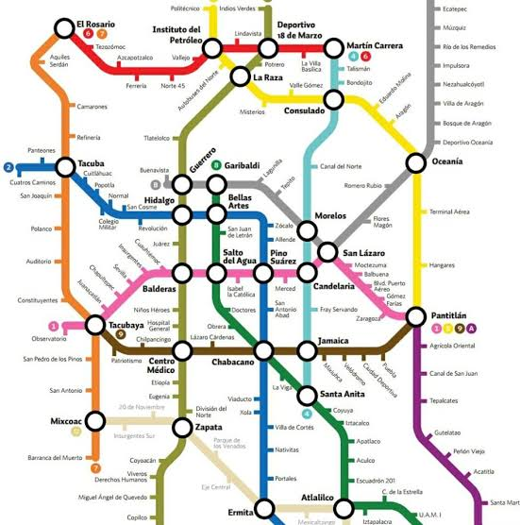
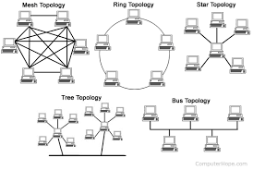
I.A - What is a network?
Notes:
Una red es una representacion de las interacciones entre individus en un Sistema
Por ejemplo Facebook
Redes computacionales
Red de aeropuertos
Nuestra sociedad misma es una red, las personas tienen diferentes tasas de interacción con otras, algunos interaccionan mas frequente o con mas personas que otras.

Slide 4
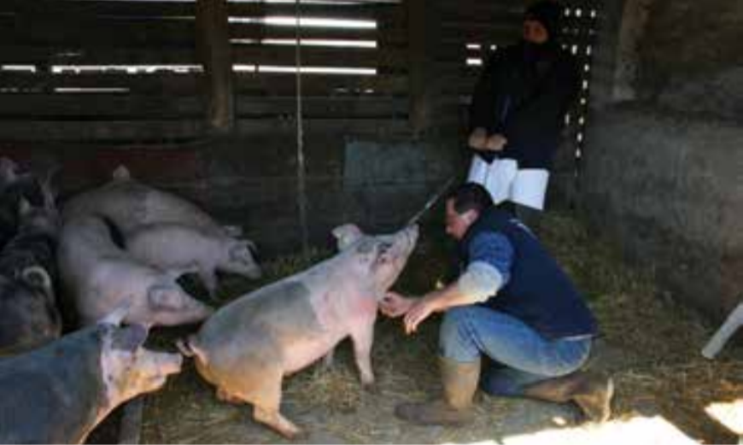
Applications in Preventative Veterinary Medicine
Uses of Networks in Preventative Veterinary Medicine
Surveillance, Prevention and Control
Define strategic nodes for cost-effective risk-based targeted intervention
Surveillance: Diagnostic testing, road checks
Pig sampling - Serbia
FAO African Swine Fever: Detection and diagnosis - 2017

Slide 5
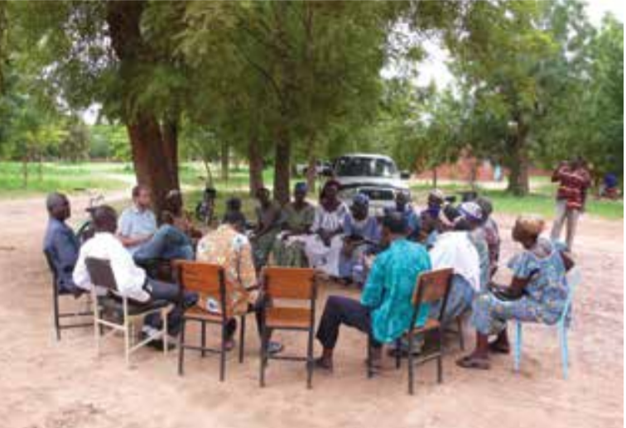
Applications in Preventative Veterinary Medicine
Uses of Networks in Preventative Veterinary Medicine
Surveillance, Prevention and Control
Define strategic nodes for cost-effective risk-based targeted intervention
Surveillance: Diagnostic testing, road checks
Prevention: Education and information, vaccination campaigns
Farmer education – Burkina Faso
FAO African Swine Fever: Detection and diagnosis - 2017

Slide 6
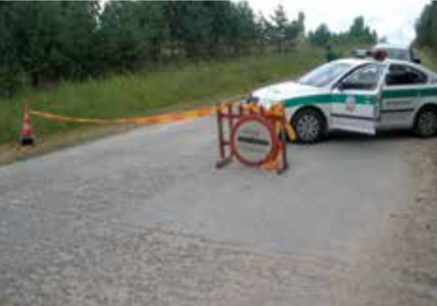
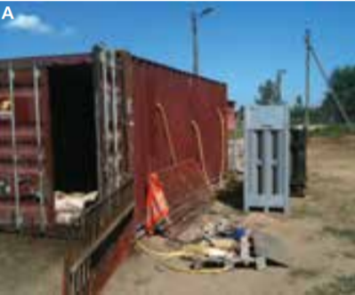
Applications in Preventative Veterinary Medicine
Uses of Networks in Preventative Veterinary Medicine
Surveillance, Prevention and Control
Define strategic nodes for cost-effective risk-based targeted intervention
Surveillance: Diagnostic testing, road checks
Prevention: Education and information, vaccination campaigns
Control: Vaccination, treatment, culling campaigns, movement restrictions
Road blocks and CO2 culling chamber - Lithuania
FAO African Swine Fever: Detection and diagnosis - 2017

Slide 7
Applications in Preventative Veterinary Medicine
Uses of Networks in Preventative Veterinary Medicine
Surveillance, Prevention and Control
Define strategic nodes for cost-effective risk-based targeted intervention
Surveillance: Diagnostic testing, road checks
Prevention: Education and information, vaccination campaigns
Control: Vaccination, treatment, culling campaigns, movement restrictions
Modelling of disease introduction and spread
P = ?
P = ?
P = ?
P = ?
P = ?

Slide 8
Applications in Preventative Veterinary Medicine
Uses of Networks in Preventative Veterinary Medicine
Surveillance, Prevention and Control
Define strategic nodes for cost-effective risk-based targeted intervention
Surveillance: Diagnostic testing, road checks
Prevention: Education and information, vaccination campaigns
Control: Vaccination, treatment, culling campaigns, movement restrictions
Modelling of disease introduction and spread
Risk Factor Analysis

Slide 9
Applications in Preventative Veterinary Medicine
Uses of Networks in Preventative Veterinary Medicine
Surveillance, Prevention and Control
Define strategic nodes for cost-effective risk-based targeted intervention
Surveillance: Diagnostic testing, road checks
Prevention: Education and information, vaccination campaigns
Control: Vaccination, treatment, culling campaigns, movement restrictions
Modelling of disease introduction and spread
Risk Factor Analysis
Outbreak investigation
Traceability of the outbreak’s origin and contact tracing
?
?
?
?

Slide 10
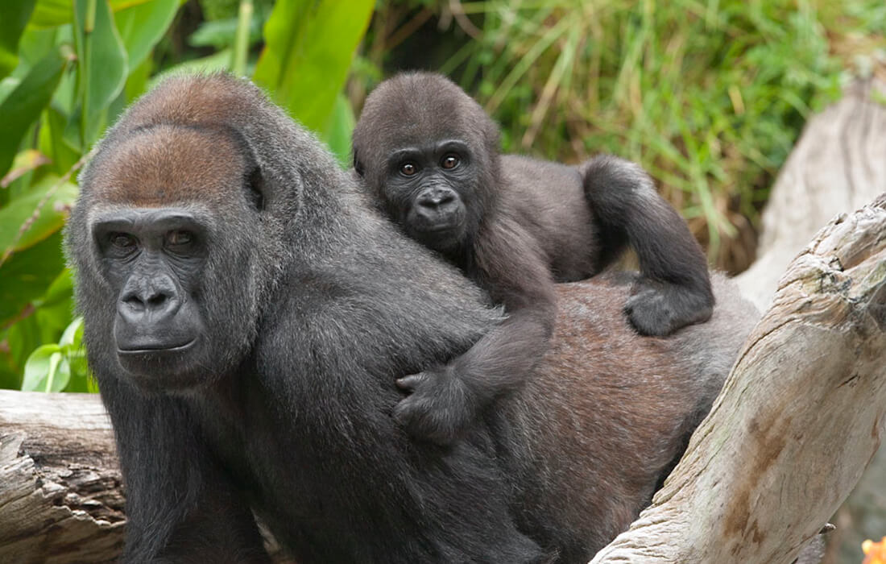
Applications in Preventative Veterinary Medicine
Uses of Networks in Preventative Veterinary Medicine
Surveillance, Prevention and Control
Define strategic nodes for cost-effective risk-based targeted intervention
Surveillance: Diagnostic testing, road checks
Prevention: Education and information, vaccination campaigns
Control: Vaccination, treatment, culling campaigns, movement restrictions
Modelling of disease introduction and spread
Risk Factor Analysis
Outbreak investigation
Traceability of the outbreak’s origin
Other uses in the animal world
Behavioral studies in social animals: i.e. contact patterns in a herd of cattle, primate behavioral studies
Source: San Diego Zoo

Slide 11
Applications in Preventative Veterinary Medicine
Uses of Networks in Preventative Veterinary Medicine
Surveillance, Prevention and Control
Define strategic nodes for cost-effective risk-based targeted intervention
Surveillance: Diagnostic testing, road checks
Prevention: Education and information, vaccination campaigns
Control: Vaccination, treatment, culling campaigns, movement restrictions
Define cost-effective risk-based targeted approaches
Modelling of disease introduction and spread
Risk Factor Analysis
Outbreak investigation
Traceability of the outbreak’s origin
Other uses in the animal world
Behavioral studies in social animals: i.e. contact patterns in a herd of cattle

Slide 12
Why represent events in a network?
To describe contact dynamics
Identify individuals that are very active
Identify individuals that are intermediate
Notes:
Identificar individuos mas activos:
Si tenemos una enfermedad en una poblacióntransmitida por contactos directos y recursos limitados, donde deberimos muestrear?
Identificar individuos intermediaries:
Si queremos implementar alguna medida de control, o vigilancia, en donde deberiamos enfocar los recursos?

Slide 13
Why represent events in a network?
Model contact dynamics:
1
0
Inference: Associations between attributes and activities in a network
Prediction: Are there reproducible patterns that we can predict?
Notes:
Los individuos amarillos son mas propensos a iniciar los contactos que los individuos verdes?
Existe alguna asociación entre el numero de contactos y algún otro atributo?

Slide 14
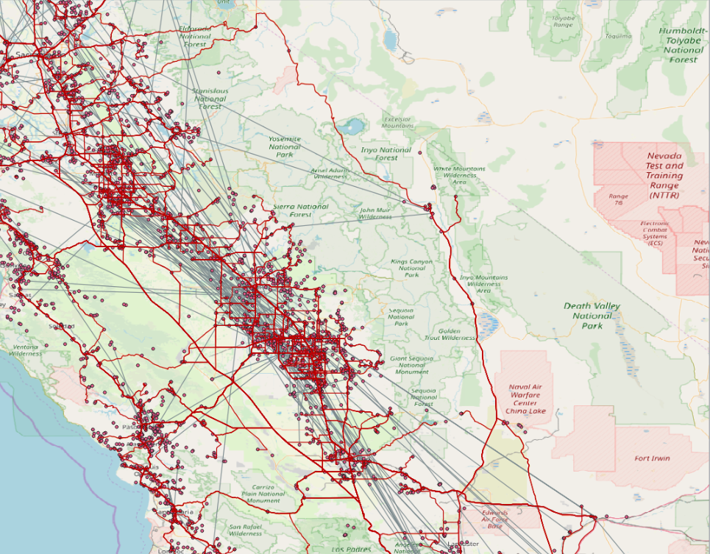
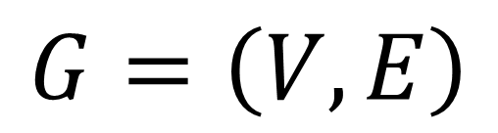
Graph theory
What is a graph? (in the context of network analysis)
“Mathematical repesentation of a network”
$$G=\left(V,E\right)$$
Where:
V = Vertice
E = Edge
Notes:
Analisis de redes sociales es aplicado en muchas areas y existen muchos diferentes nombres para los mismos terminos.

Slide 15
I.B - Elements of a network
Nodes (vertices)
Agents or individuals forming a network
V = {1, 2, 3, … , i}

Slide 16
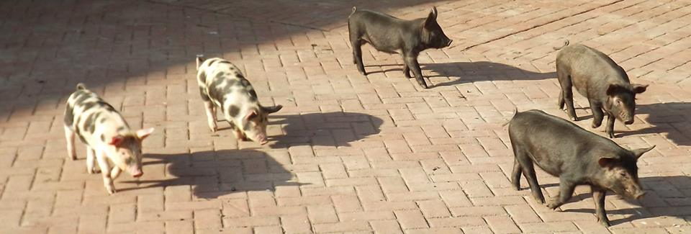
I.B - Elements of a network
Nodes (vertices)
Agents or individuals forming a network:
farms, animals, humans, markets
V = {1, 2, 3, … , i}

Slide 17
I.B - Elements of a network
Edges (links)
Connection between a pair of nodes (dyad)
E = {(1, 2), (1, 3), … , (i, j)}
In a network, connected nodes are considered as neighbours
Each of the connected nodes belongs to a neighborhood

Slide 18
I.B - Elements of a network
Edges (links)
Connection between a pair of nodes (dyad):
Animal shipments, human movements, social contacts
E = {(1, 2), (1, 3), … , (i, j)}
In a network, connected nodes are considered as neighbours
Each of the connected nodes belongs to a neighborhood

Slide 19
I.B - Elements of a network
Directionality
E = {(1→2), (1→3), … , (i →j)}
Notes:
Una red puede ser direccionadas o no direccionadas dependiendo del tipo de relacion entre los pares de nodos.
En redes no direcionadas, la relacion entre nodos puede ser en cualquier direccion.
En redes direccionadas existe un origen y destino, que explica la direccion de la relacion.

Slide 20
I.B - Elements of a network
Atributes
Nodes: farm size, type…
Edges: movement size, cause…
1
V = {0, 1, 0, … , i}
0
E = {(1), (3), … , (x_{i})}

Slide 21
I.C.a - Data sources
Define nodes:
What is the unit of analysis (e.g. farm, animal, etc)
Define edges:
Frequency of contacts
Duration of contacts
Notes:
Que tan bueno es nuestro Sistema de reportes?
Que tanto impacto tendran las subnotificaciones? (regiones con menor tasa de reportes).

Slide 22
I.C.a - Data structure
Nodes dataset
ID | Farm | Farm size | Farm type
1 | Swine and company | 800 | fattening farm
2 | Les Cochonets | 1200 | sow farm
3 | The farmhouse | 50 | small-scale farm
4 | The Boar | 20 | reproductive males
5 | Ham & sausage | 65 | slaughterhouse
6 | The trading post | 0 | market
Edges dataset
ID_origin | ID_destination | Shipment size | Date | Reason
2 | 6 | 10 | 02-25-2018 | Sale of adult sows
2 | 1 | 15 | 03-12-2018 | Piglets for fattening
4 | 1 | 1 | 10-15-2017 | Insemination
1 | 5 | 100 | 06-30-2018 | Slaughter
6 | 3 | 2 | 07-10-2018 | Sale of adult sows
2 | 1 | 100 | 02-15-2018 | Piglets for fattening
Notes:
Spatial coordinates

Slide 23
Measurement of contacts
Retrospective
National movement records
Farm registry and population census
Surveys
Prospective
Visual observation
Tracking with GPS or PIT (Passive Integrated Transporter) systems

Slide 24
I.C.a - Data sources
Passive Surveillance
Mandatory movement registries
Population census
GPS data (entire population)
Complete network
Notes:
Que tan bueno es nuestro Sistema de reportes?
Que tanto impacto tendran las subnotificaciones? (regiones con menor tasa de reportes).

Slide 25
I.C.a - Data sources
Passive Surveillance
Mandatory movement registries
Population census
GPS data (entire population)
Complete network
Impact of underreporting
Notes:
Que tan bueno es nuestro Sistema de reportes?
Que tanto impacto tendran las subnotificaciones? (regiones con menor tasa de reportes).

Slide 26
I.C.a - Data sources
Active surveillance
Surveys
Observation of a sample of the population
Subgraph sampling and incomplete network

Slide 27
I.C.b - Sampling method
Random Sampling Methods
Node induced
Sample a group of nodes
Identify all contacts between these nodes
Edge induced
Sample a group of edges
Identify all nodes connected to these edges

Slide 28
I.C.b - Sampling method
Egocentric Sampling
Sample a group 1 of nodes
Identify all contacts linked members of group 1
Identify all nodes (group 2) directly connected to group 1
Identify all contacts between members of group 2

Slide 29
I.C.b - Sampling method
Link-tracing
(respondent driven sampling)
We follow a node of specific interests and record its previous contacts
Similar to Snowball sampling

Slide 30
Table of contents
Introduction to networks
What is a network?
Elements of a network
Data sources and Sampling methods
Static network analysis
Network simplification
Network properties
General properties
Local properties
Weak and Strong component
Notes:
Cuando describimos las caracteristias de la red, Podemos describer:
Caracteristicas generals, que nos daran una perspectiva general de como esta la red
Caracteristicas locales, que nos daran informacion a nivel de nodo o edge

Slide 31
Static Network Analysis
Static Network Analysis
Network Type
Dynamic Network
Static Network
Time = t1
Time = t2
Time = t3
Time = t4

Slide 32
II.A - Network simplification
Network Simplification
Loops
Are they important?
Multiple Edges
Meaning? Social/Commercial relationship? Useful for modeling?
Directed or undirected
Is it relevant to disease transmission in a given context: direct animal contact vs shipment

Slide 33
II.B - Network properties
General properties
Local properties
Notes:
Cuando describimos las caracteristias de la red, Podemos describer:
Caracteristicas generals, que nos daran una perspectiva general de como esta la red
Caracteristicas locales, que nos daran informacion a nivel de nodo o edge

Slide 34
II.B.a - General properties
Size: Number of nodes in the network (1 to ∞)
Diameter: The shortest path between the most distant nodes (1 to ∞)
Notes:
El tamaño de la red esta definido por el numero de nodos en la red
El Diametro es el camino mas corto entre

Slide 35
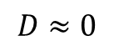
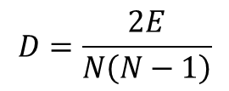
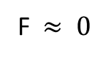
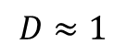
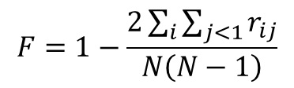
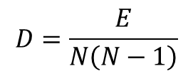
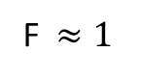
II.B.a - General properties
Density: Ratio of all observed edges in network to all theoretical edges that could exist (0 to 1)
Fragmentation: Proportion of pairs of nodes that are not connected to each other. High fragmentation means more isolated nodes
$$D=\frac{E}{N\left(N−1\right)}$$
$$D=\frac{2E}{N\left(N−1\right)}$$
$$F=1−\frac{2\sum_{i}{\sum_{j<1}{r_{ij}}}}{N\left(N−1\right)}$$
$$D≈1$$
$$D≈0$$
F$≈ 0$
F$≈1$
Notes:
Existe una relación entre D y F, Redes altamente conectadas presentaran mayor densidad y menor fragmentación, redes poco conectadas presentaran mayor fragmentación y menor densidad.

Slide 36
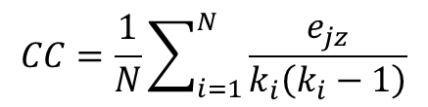
II.B.a - General properties
Clustering coefficient: The probability of individual nodes being connected
Values of 1 indicates that all nodes are directly connected to all others. Value of 0 indicates absence of contacts.
$$CC=\frac{1}{N}\sum_{i=1}^{N}{\frac{e_{jz}}{k_{i}\left(k_{i}−1\right)}}$$
Notes:
e_jz: number of nodes connecting node j and z, which are neighbours of node I
K_i degree of node i

Slide 37
II.B - Network properties
General properties
Local properties
Notes:
Cuando describimos las caracteristias de la red, Podemos describer:
Caracteristicas generals, que nos daran una perspectiva general de como esta la red
Caracteristicas locales, que nos daran informacion a nivel de nodo o edge

Slide 38
II.B.b - Local properties
Centrality measures:
Degree
Betwenness
Closeness

Slide 39
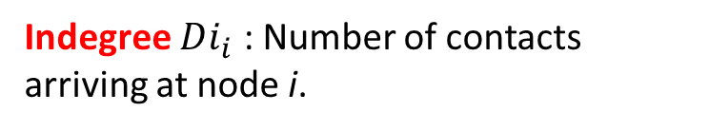
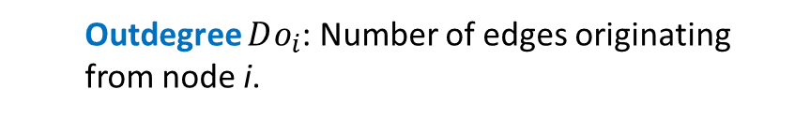
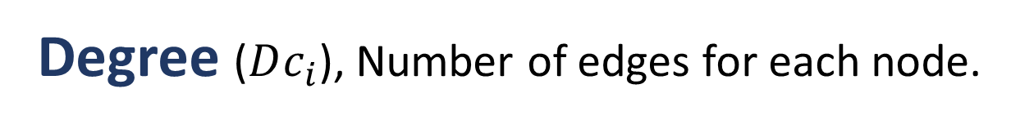
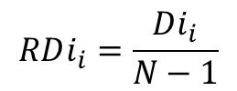
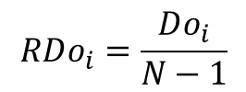
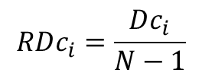
II.B.b - Local properties
Degree ($Dc_{i}$), Number of edges for each node.
Outdegree $Do_{i}$: Number of edges originating from node i.
Indegree $Di_{i}$ : Number of contacts arriving at node i.
Relative degree centrality
Outdegree = 3
$$RDc_{i}=\frac{Dc_{i}}{N−1}$$
$$RDi_{i}=\frac{Di_{i}}{N−1}$$
Indegree = 3
$$RDo_{i}=\frac{Do_{i}}{N−1}$$

Slide 40
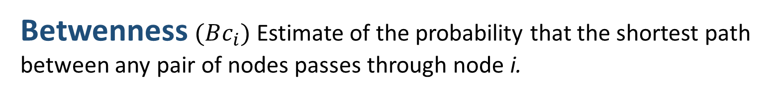
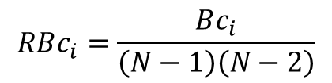
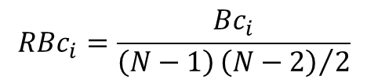
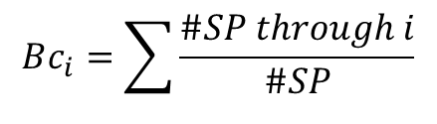
II.B.b - Local properties
Betwenness $(Bc_{i})$ Estimate of the probability that the shortest path between any pair of nodes passes through node i.
$$Bc_{i}=\sum{\frac{\#SP through i}{\#SP}}$$
Relative betweenness centrality
For non-directed networks
$$RBc_{i}=\frac{Bc_{i}}{\left(N−1\right){\left(N−2\right)}/2}$$
For directed networks
$$RBc_{i}=\frac{Bc_{i}}{\left(N−1\right)\left(N−2\right)}$$

Slide 41
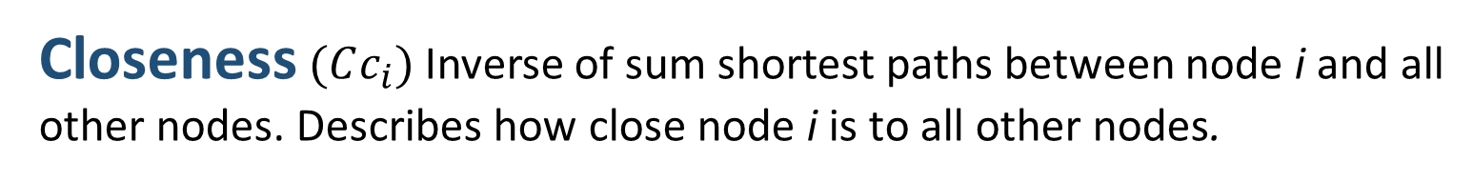
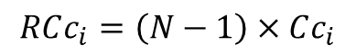
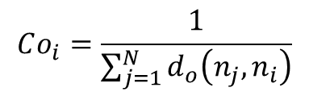
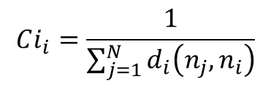
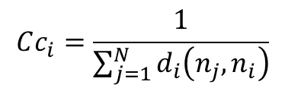
II.B.b - Local properties
Closeness$(Cc_{i})$ Inverse of sum shortest paths between node i and all other nodes. Describes how close node i is to all other nodes.
Non-directed networks:
Relative closeness centrality
$$Cc_{i}=\frac{1}{\sum_{j=1}^{N}{d_{i}\left(n_{j},n_{i}\right)}}$$
$$RCc_{i}=\left(N−1\right)×Cc_{i}$$
Directed networks:
In-closeness
Out-closeness
1 c
1 + 1 + 1 + 2
$$Ci_{i}=\frac{1}{\sum_{j=1}^{N}{d_{i}\left(n_{j},n_{i}\right)}}$$
$$Co_{i}=\frac{1}{\sum_{j=1}^{N}{d_{o}\left(n_{j},n_{i}\right)}}$$
1 c
1 + 2 + 2 + 3
Notes:
d(n_i, n_j) numero de nodos en la red

Slide 42
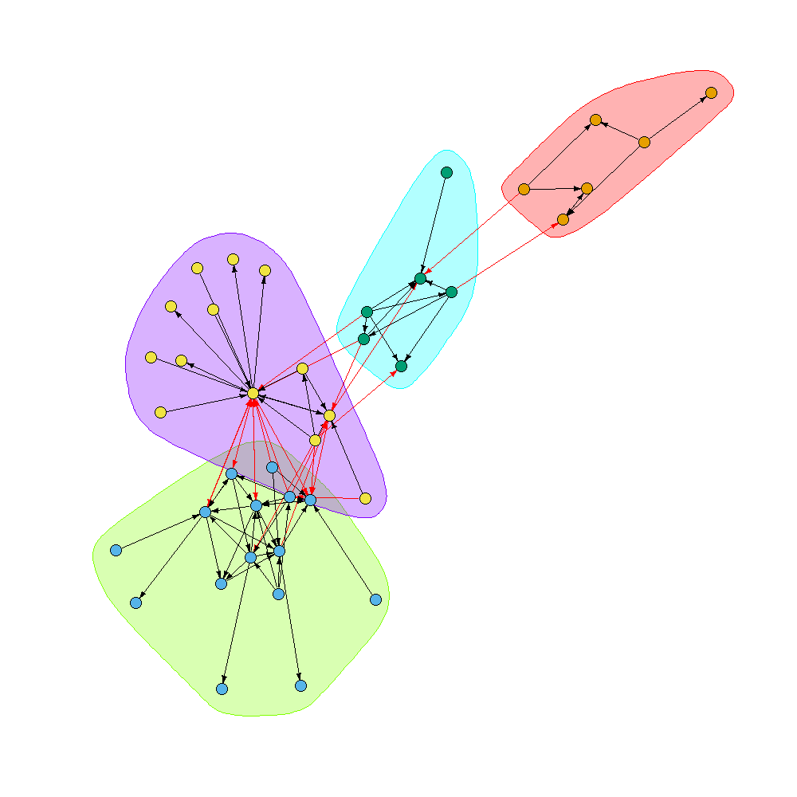
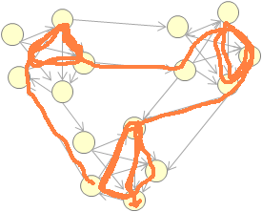
II.C - Detection of communities
Communities: Many intra-community contacts and few inter-community contacts
Strong Component
A subset of the network in which each pair of nodes i and j can be reached by all the others
There are many algorithms to detect communities, walktrap being one of the most popular.
I generates random paths between nodes to detect zones where it circulates more frequently within a group of nodes.
Notes:
Aplicacion practica: si una enfermedad es introducida en un nodo del strong component, es mas probable que se disemine entre la población.

Slide 43

Limitations of static network analysis and graph
Network size and legibility
No visible timeline in a static network
Doesn’t take into account spatial characteristics
Location based on network algorithm

Slide 44
Questions?
Contact: jpgo@ucdavis.edu, jnbaron@ucdavis.edu
jpablo91.github.io

Slide 45
Questions?
Strong Component

Slide 46
Questions?

Slide 47
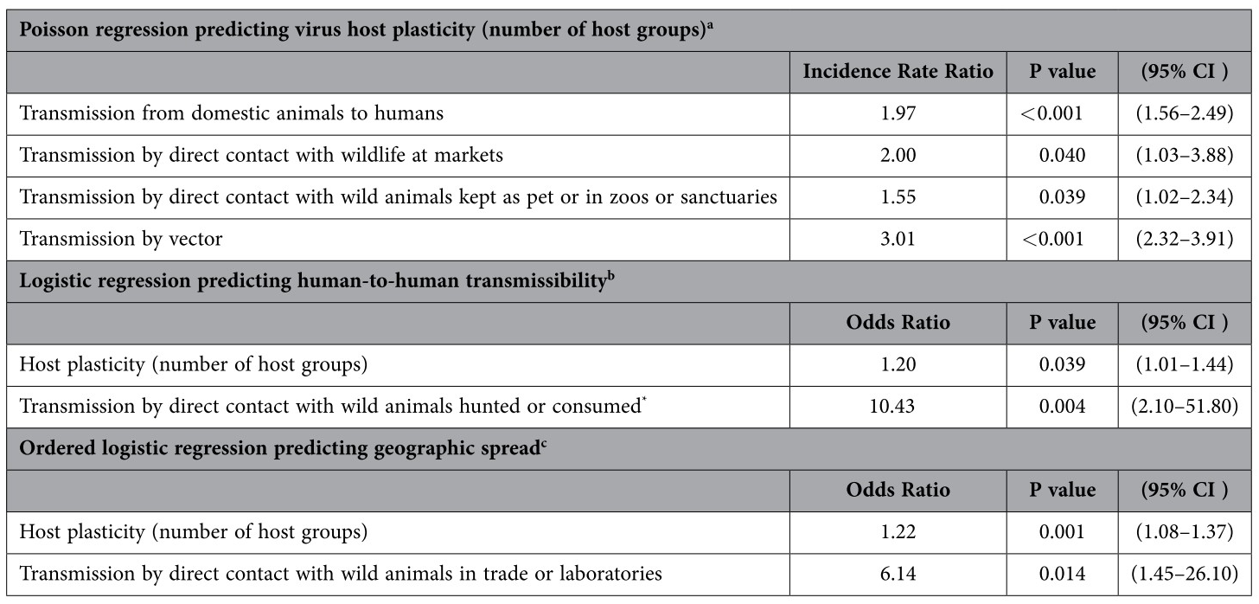
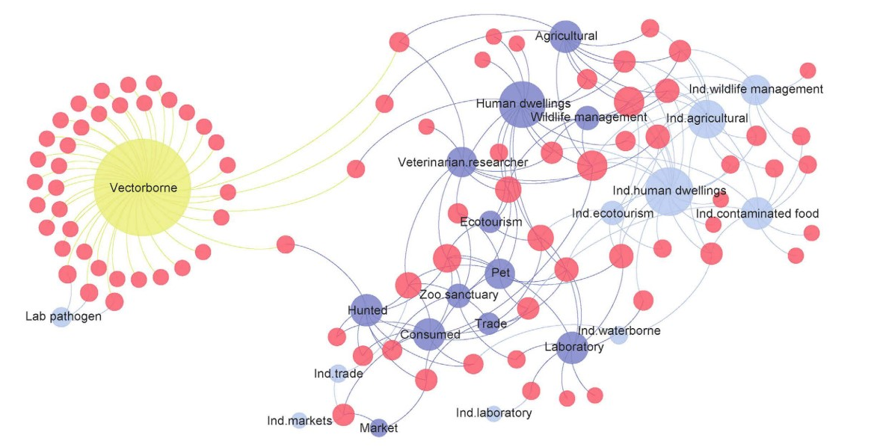
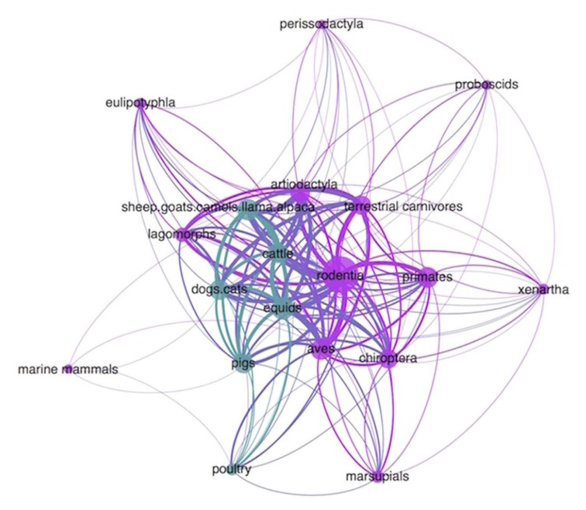
Example
Kreuder Johnson et al, 2015
Examine the transmission mechanisms and hosts involved in zoonotic transmission
Identify viruses with “high plasticity”

